Slide 1
Variables, Constants and Assignment Statements
Programming IT Course
GNU C
Lecture 2

Slide 2
Once a person has understood the way variables are used in programming, he has understood the quintessence of programming.
E. W. DIJKSTRA

Slide 3
Lecture Contents
Variables and Named Constants
Selecting a Name for a Memory Location
Selecting a Data Type for a Memory Location
How Data is Stored in Internal Memory
Type Casting
Reserving a Named Constants/a Variable
Arithmetic Operators
Exercises

Slide 4
Lecture Objectives
Distinguish between a variable, a named constant, and a literal constant
Select an appropriate name, data type, and initial value for a memory location
Explain how data is stored in memory
Reserve and initialize a memory location
Type cast data
Use an assignment statement to assign data to a variable
Include arithmetic operators in an expression
Create a console application

Slide 5
I. Variables and Named Constants
Variables and Named Constants are locations where a program can temporarily store data.
Two types of memory locations are available for your program to use: variable memory locations and named constant memory locations.
The difference between the two types is that the contents of a variable memory location can change (vary) as the program is running, whereas the contents of a named constant memory location cannot.

Slide 6
I.1. Selecting a Name for a Memory Location
Keywords
These are reserved words of the C language. For example, int, float, if, else, for, while etc.
Identifiers
An identifier is a sequence of letters and digits, but must start with a letter. Underscore ( _ ) is treated as a letter. Identifiers are case sensitive. Identifiers are used to name variables, functions etc.
Valid: Root, _getchar, __sin, x1, x2, x3, x_1, If
Invalid: 324, short, price$, My Name
Constants
Constants like 13, ‘a’, 1.3e-5 etc.
String Literals
A sequence of characters enclosed in double quotes as “…”. For example “13” is a string literal and not number 13. ‘a’ and “a” are different.
White Spaces
Spaces, new lines, tabs, comments (A sequence of characters enclosed in /* and */) etc. These are used to separate the adjacent identifiers, keywords and constants.

Slide 7
Constants
Numerical Constants
Constants like 12, 253 are stored as int type. No decimal point.
12L or 12l are stored as long int.
12U or 12u are stored as unsigned int.
12UL or 12ul are stored as unsigned long int.
Numbers with a decimal point (12.34) are stored as double type.
Numbers with exponent (12e-3 = 12x10⁻³) are stored as double type.
12.34f or 1.234e1f are stored as float type.
These are not valid constants:
25,000 7.1e 4 $200 2.3e-3.4 etc.

Slide 8
Constants
Character and string constants
‘c’, a single character in single quotes are stored as char type. Some special character are represented as two characters in single quotes.
‘\n’ = newline, ‘\t’= tab, ‘\\’ = backlash, ‘\”’ = double quotes. Char constants also can be written in terms of their ASCII code. ‘\060’ = ‘0’ (Decimal code is 48).
A sequence of characters enclosed in double quotes is called a string constant or string literal. For example:
“Charu” “A” “3/9” “x = 5”

Slide 9
Variables
Naming a Variable
Must be a valid identifier
Must not be a keyword
Names are case sensitive
Variables are identified by only first 32 characters
Library commonly uses names beginning with _
Naming Styles: Uppercase style and Underscore style
lowerLimit lower_limit
incomeTax income_tax

Slide 10
Exercises
Q1: Which of the followings is/are valid identifier(s)?
_getchar
x_square
If_Else
All of them
Q2: To define number 20 as a string literal, the definition is _____.
‘20’
“20”
#20
None of them

Slide 11
I.2. Selecting a Data Type for a Memory Location
Integral Types
Integers are stored in various sizes. They can be signed or unsigned.
Example
Suppose an integer is represented by a byte (8 bits).
Leftmost bit is the sign bit. If the sign bit is 0, the number is treated as positive.
Bit pattern 01001011 = 75 (decimal)
The largest positive number is 01111111 = 2⁷ – 1 = 127
Negative numbers are stored as two’s complement or as one’s complement.
-75 = 10110100 (one’s complement)
-75 = 10110101 (two’s complement)
Notes:
C is strongly typed. The variables and constants etc have a certain data types. All variables could have been double type, but then multiplying double numbers is very expensive. So the various data types have been provided for the reason of efficiency and ease of handling.

Slide 12
I.2. Selecting a Data Type for a Memory Location
Integral Types
char Stored as 8 bits.
Unsigned 0 to 255. Signed -128 to 127.
short Stored as 16 bits.
Unsigned 0 to 65535. Signed -32768 to 32767.
int Same as either short or long int.
long Stored as 32 bits.
Unsigned 0 to 4294967295. Signed -2147483648 to 2147483647
Notes:
C guarantees only following:
Sizeof(short) <= sizeof(int) <= sizeof(long).

Slide 13
I.2. Selecting a Data Type for a Memory Location
Floating-Point Numbers
Floating point numbers are rational numbers. Always signed numbers.
float Approximate precision of 6 decimal digits.
Typically stored in 4 bytes with 24 bits of signed mantissa and 8 bits of signed exponent.
double Approximate precision of 14 decimal digits.
Typically stored in 8 bytes with 56 bits of signed mantissa and 8 bits of signed exponent.
One should check the file limits.h to what is implemented on a particular machine.
string Stored as 8 bits per character.
contains zero or more characters
boolean Stored as 8 bits.
contains boolean values (true/false)

Slide 14
I.3. How Data is Stored in Internal Memory
Decimal number system (base 10) |  | Decimal number | 10⁷ | 10⁶ | 10⁵ | 10⁴ | 10³ | 10² | 10¹ | 10⁰
 |  | 110 |  |  |  |  |  | 1 | 1 | 0
 |  | 342 |  |  |  |  |  | 3 | 4 | 2
 |  | 31509 |  |  |  | 3 | 1 | 5 | 0 | 9
Binary number system (base 2) | Binary number | Decimal equivalent of binary number | 2⁷ | 2⁶ | 2⁵ | 2⁴ | 2³ | 2² | 2¹ | 2⁰
 | 110 | 6 |  |  |  |  |  | 1 | 1 | 0
 | 11010 | 26 |  |  |  | 1 | 1 | 0 | 1 | 0
 | 1001 | ? |  |  |  |  | 1 | 0 | 0 | 1
Figure 1.1 Comparison of the decimal and binary number systems

Slide 15
Character | ASCII | Binary | Character | ASCII | Binary | Character | ASCII | Binary
0 | 48 | 00110000 | K | 75 | 01001011 | g | 103 | 01100111
1 | 49 | 00110001 | L | 76 | 01001100 | h | 104 | 01101000
2 | 50 | 00110010 | M | 77 | 01001101 | i | 105 | 01101001
3 | 51 | 00110011 | N | 78 | 01001110 | j | 106 | 01101010
4 | 52 | 00110100 | O | 79 | 01001111 | k | 107 | 01101011
5 | 53 | 00110101 | P | 80 | 01010000 | l | 108 | 01101100
6 | 54 | 00110110 | Q | 81 | 01010001 | m | 109 | 01101101
7 | 55 | 00110111 | R | 82 | 01010010 | n | 110 | 01101110
8 | 56 | 00111000 | S | 83 | 01010011 | o | 111 | 01101111
9 | 57 | 00111001 | T | 84 | 01010100 | p | 112 | 01110000
: | 58 | 00111010 | U | 85 | 01010101 | q | 113 | 01110001
; | 59 | 00111011 | V | 86 | 01010110 | r | 114 | 01110010
A | 65 | 01000001 | W | 87 | 01010111 | s | 115 | 01110011
B | 66 | 01000010 | X | 88 | 01011000 | t | 116 | 01110100
C | 67 | 01000011 | Y | 89 | 01011001 | u | 117 | 01110101
D | 68 | 01000100 | Z | 90 | 01011010 | v | 118 | 01110110
E | 69 | 01000101 | a | 97 | 01100001 | w | 119 | 01110111
F | 70 | 01000110 | b | 98 | 01100010 | x | 120 | 01111000
G | 71 | 01000111 | c | 99 | 01100011 | y | 121 | 01111001
H | 72 | 01001000 | d | 100 | 01100100 | z | 122 | 01111010
I | 73 | 01001001 | e | 101 | 01100101
J | 74 | 01001010 | f | 102 | 01100110

Slide 16
Exercises
Ex1: Convert the following numbers from decimal to binary number systems:
174 487
Ex2: Convert the following numbers from binary to decimal number systems:
10011101 1011001101
Ex3: Convert the following numbers from decimal to octal (base 8) number systems:
395 544
Ex4: Convert the following numbers from octal (base 8) to decimal number systems:
152 217
Ex5: Convert the following numbers from decimal to hexa (base 16) number systems:
1001 2513
Ex6: Convert the following numbers from hexa (base 16) to decimal number systems:
2CD4 ACE

Slide 17
They’ll never be happy together. He’s not her type.
OVERHEARD AT A COCKTAIL PARTY

Slide 18
I.4. Type Conversions
The operands of a binary operator must have the same type and the result is also of the same type.
Integer division:
c = ( 9 / 5 ) * ( f – 32 )
The operands of the division are both int, and hence, the result also would be int. For correct results, one may write:
c = ( 9.0 / 5.0 ) * ( f – 32 )
In case the two operands of a binary operator are different, but compatible, then they are converted to the same type by the compiler. The mechanism (set of rules) is called Automatic Type Casting.
c = ( 9.0 / 5 ) * ( f – 32 )
It is possible to force a conversion of an operand. This is called Explicit Type Casting.
c = ( (float)9 / 5 ) * ( f – 32 )

Slide 19
Automatic Type Casting
char and short operands are converted to int
Lower data types are converted to the higher data types and result is of higher type.
The conversions between unsigned and signed types may not yield intuitive results.
Example
float f; double d; long l;
int i; short s;
d + f f will be converted to double
i / s s will be converted to int
l / i i is converted to long; long result
Hierarchy
double
float
long
int
short and char

Slide 20
Explicit Type Casting
The general form of a type casting operator is:
(type-name) expression
It is generally a good practice to use explicit casts than to rely on automatic type conversions.
Example
c = (float)9 / 5 * ( f – 32 )
float to int conversion causes truncation of fractional part
double to float conversion causes rounding of digits
long int to int causes dropping of the higher order bits

Slide 21
Exercises
Write a C assignment statement that assigns the value 23.25 to a float variable named price.
Write a C assignment statement that assigns the letter T to a char variable named insured.
The assignment statement answer = 8 / 4 * 3 – 5 % 2 assigns the value _____ to the answer variable (The answer variable is an int variable).
What value will be assigned to the answer variable in question 3 if the variable is float variable ?
price = float(23.25);
insured = ‘T’;
5
5.0

Slide 22
II. Reserving a Named Constants/a Variable
II.1. Declaring a Variable
Each variable used must be declared.
A form of a declaration statement is
data-type var1, var2,…;
Declaration announces the data type of a variable and allocates appropriate memory location. No initial value (like 0 for integers) should be assumed.
It is possible to assign an initial value to a variable in the declaration itself.
data-type var = expression;
Examples
int sum = 0;
char newLine = ‘\n’;
float epsilon = 1.0e-6;

Slide 23
II.2. Global and Local Variables
/* Compute Area and Perimeter of a circle */
#include <stdio.h>
float pi = 3.14159; /* Global */
main() {
float rad; /* Local */
printf(“Enter the radius”);
scanf(“%f”, &rad);
if (rad > 0.0) {
float area = pi * rad * rad;
float peri = 2 * pi * rad;
printf(“Area = %f\n”, area);
printf(“Peri = %f\n”, peri);
}
else
printf(“Negative radius\n”);
printf(“Area = %f\n”, area);
}
Global Variables
These variables are declared outside all functions.
Life time of a global variable is the entire execution period of the program.
Can be accessed by any function defined below the declaration, in a file.

Slide 24
II.2. Global and Local Variables
/* Compute Area and Perimeter of a circle */
#include <stdio.h>
float pi = 3.14159; /* Global */
main() {
float rad; /* Local */
printf(“Enter the radius”);
scanf(“%f”, &rad);
if (rad > 0.0) {
float area = pi * rad * rad;
float peri = 2 * pi * rad;
printf(“Area = %f\n”, area);
printf(“Peri = %f\n”, peri);
}
else
printf(“Negative radius\n”);
printf(“Area = %f\n”, area);
}
Local Variables
These variables are declared inside some functions.
Life time of a local variable is the entire execution period of the function in which it is defined.
Cannot be accessed by any other function.
In general variables declared inside a block are accessible only in that block.

Slide 25
III. Arithmetic Operators
Arithmetic Operators
+, - , *, / and the modulus operator %
+ and – have the same precedence and associate left to right
3 – 5 + 7 = ( 3 – 5 ) + 7 ≠ 3 – ( 5 + 7 )
3 + 7 – 5 + 2 = ( ( 3 + 7 ) – 5 ) + 2
*, /, % have the same precedence and associate left to right
The +, - group has lower precedence than the *, /, % group
3 – 5 * 7 / 8 + 6 / 2
3 – 35 / 8 + 6 / 2
3 – 4.375 + 6 / 2
3 – 4.375 + 3
-1.375 + 3
1.625

Slide 26
Arithmetic Operators
% is a modulus operator. x%y results in the remainder when x is divided by y and is zero when x is divisible by y.
Cannot be applied to float or double variables.
Example
if ( num % 2 == 0 )
printf(“%d is an even number\n”, num);
else
printf(“%d is an odd number\n”, num);

Slide 27
Relational Operators
<, <=, > >=, ==, != are the relational operators. The expression:
operand1 relational-operator operand2
takes a value of 1 (int) if the relationship is true and 0 (int) if relationship is false.
Example
int a = 25, b = 30, c, d;
c = a < b;
d = a > b;
value of c will be 1 and that of d will be 0.

Slide 28
Logical Operators
&&, || and ! are the three logical operators
expr1 && expr2 has a value 1 if expr1 and expr2 both are nonzero
expr1 || expr2 has a value 1 if expr1 and expr2 either is nonzero
!expr1 has a value 1 if expr1 is zero else 0
Example
if (marks >= 40 && attendance >= 75) grade = ‘P’
if (marks < 40 || attendance < 75) grade = ‘N’

Slide 29
Assignment operators
The general form of an assignment operator is:
v op= exp
where v is a variable and op is a binary arithmetic operator. This statement is equivalent to:
v = v op (exp)
a = a + b can be written as a += b
a = a * b can be written as a *= b
a = a / b can be written as a /= b
a = a – b can be written as a –= b

Slide 30
Assignment operators
Increment/decrement operators
=
+=
-=
*=
/=
%=
++ ++a
++ a++
-- --a
-- a--

Slide 31
Increment/decrement operators
Example 1:
main()
{
int c;
c = 5;
printf(“%d\n”, c);
printf(“%d\n”, c++);
printf(“%d\n\n”, c);
c = 5;
printf(“%d\n”, c);
printf(“%d\n”, ++c);
printf(“%d\n”, c);
return 0;
}
5
5
6
5
6
6

Slide 32
Increment and Decrement Operators
The operators ++ and -- are called increment and decrement operators.
a++ and ++a are equivalent to a += 1
a-- and --a are equivalent to a -= 1
++a op b is equivalent to a ++; a op b;
a++ op b is equivalent to a op b; a++;
Example
Let b = 10 then:
(++b) + b + b = 33
b + (++b) + b = 33
b + b + (++b) = 31
b + b * (++b) = 132

Slide 33
Exercises
Given the following program segment:
main() {
int c;
c = 10;
printf(“%d\n”, c);
printf(“%d\n”, c--);
printf(“%d\n”, ++c);
printf(“%d\n”, c);
return 0;
}
The output will be: ________________
The following statement where T is true and F is false, T || F && F || T
is true
is false
is syntax error
not applicable in C language
Let b = 5 then (b--) + (++b) + b =
17
16
15
14
10 – 10 – 10 – 10

Slide 34
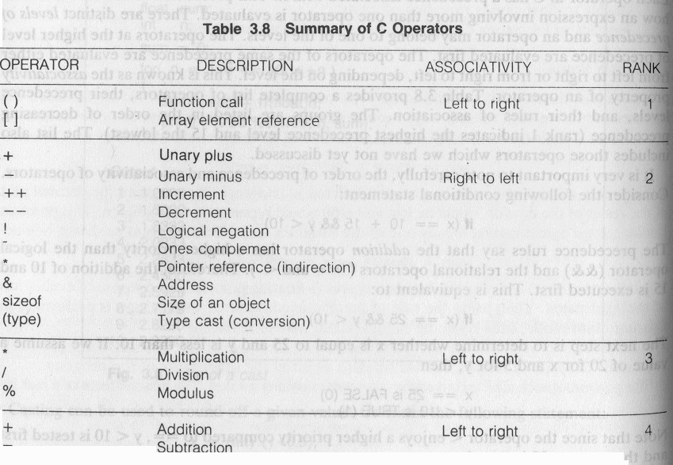
III.1. Precedence and Order of evaluation

Slide 35
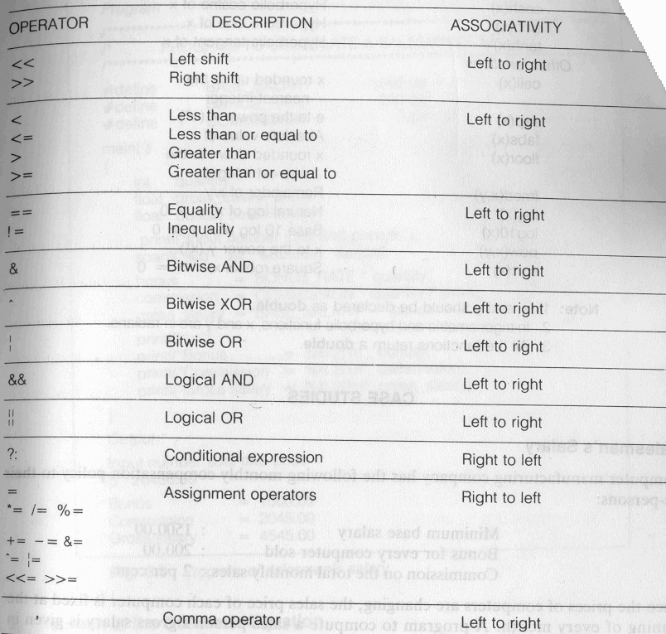
III.1. Precedence and Order of evaluation

Slide 36
III.2. Floating Point Arithmetic
Representation
All floating point numbers are stored as ±0d₁d₂…d_{p}xB^{e} such that d₁ is nonzero. B is the base. p is the precision or number of significant digits. e is the exponent. All these put together have finite number of bits (usually 32 or 64 bits ) of storage.
Example
Assume B = 10 and p = 3
23.7 = +0.237E2
23.74 = +0.237E2
37000 = +0.370E5
37028 = +0.370E5
-0.000124 = -0.124E-4

Slide 37
III.2. Floating Point Arithmetic
Representation
S_{k} = { x | B^{k-1} <= x < B^{k} }. Number of elements in each S_{k} is same. In the previous example it is 900.
Gap between successive numbers of S_{k} is B^{k-p}.
B^{1-p} is called machine epsilon. It is the gap between 1 and next representable number.
Underflow and Overflow occur when number cannot be represented because it is too small or too big.
Two floating points are added by aligning decimal points.
Floating point arithmetic is not associative and distributive.

Slide 38
IV. Exercises
Ex1: Write a C statement that multiplies a variable named taxRate by a variable named grossPay, and assigns the result to a variable named tax.
Ex2: Jenny wants a program that will allow the company’s salesclerks to enter the length, width, in meter, of a rectangle, and the price of a square meter of tile. (The length, width, and price may contain decimal places). The program should display the area of the rectangle and the total price of the tile.
Ex3: Temp Employers wants a program that will allow the company’s clerks to enter an employee’s name and the number of hours the employee worked during the month. (The number of hours worked will always be an integer). The program will display the name, number of weeks (assume a 40-hour week), days (assume an eight-hour day), and hours worked. For example, if the employee enters the number 70, the program will display the employee’s name, then 1 week, 3 days, and 6 hours.

Slide 39
Questions ?

